Slide 1


Introduction to Parallax Servos
電機系
Servo簡介
清華大學電機系 劉靖家
EE2405 Embedded System Labs

Slide 2
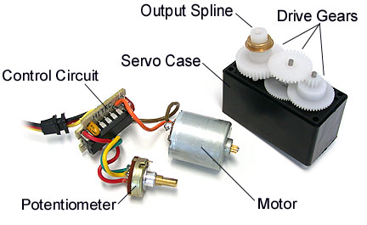
What makes a Servo
Servo motors and are constructed out of basic DC motors, by adding:
some gear reduction
a position sensor for the motor shaft
an electronic circuit that controls the motor's operation

Slide 3
Servo Characteristics
They are typically rated by torque and speed.
A servo rated 40 ounce-in/.21 means that at 1 inch from the hub, the servo can exert 40 ounces of force and move 60 deg in 0.21 sec.
Servos are extremely useful in robotics.
The motors draws power proportional to the mechanical load.
The amount of power applied to the motor is proportional to the distance it needs to travel. So, if the shaft needs to turn a large distance, the motor will run at full speed. If it needs to turn only a small amount, the motor will run at a slower speed. This is called proportional control.

Slide 4
Potentiometer Feedback Control
The potentiometer allows the control circuitry to monitor the current angle of the servo motor.
The motor, through a series of gears, turns the output shaft and the potentiometer simultaneously.
The potentiometer is fed into the servo control circuit and when the control circuit detects that the position is correct, it stops the motor. If the control circuit detects that the angle is not correct, it will turn the motor the correct direction until the angle is correct.
Normally a servo is used to control an angular motion of between 0 and 180 degrees. It is not mechanically capable (unless modified) of turning any farther due to the mechanical stop build on to the main output gear.

Slide 5
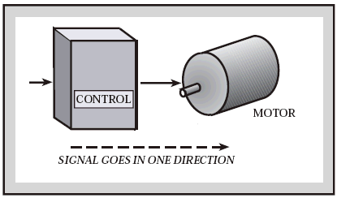
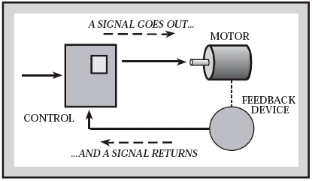
Feed-back loop
open-loop
closed-loop

Slide 6
Hitec HS-311 Servo
Dimensions | 1.57" x 0.78" x 1.43" (39.88 x 19.81 x 36.32mm)
Product Weight | 1.52oz (43g)
Output Shaft Style | 24 tooth (C1) spline
Voltage Range | 4.8V - 6.0V
No-Load Speed (4.8V) | 0.19sec/60°
No-Load Speed (6.0V) | 0.15sec/60°
Stall Torque (4.8V) | 42 oz/in (3.0 kg/cm)
Stall Torque (6.0V) | 51 oz/in (3.7 kg/cm)
Max PWM Signal Range (Standard) | 575-2460μsec
Travel per µs (out of box) | .107°/μsec
Max Travel (out of box) | 202.5°
Pulse Amplitude | 3-5V
Operating Temperature | -20°C to +60°C
Current Drain - idle (4.8V) | 7.4mA
Current Drain - idle (6.0V) | 7.7mA
Current Drain - no-load (4.8V) | 160mA
Current Drain - no-load (6V) | 180mA
Continuous Rotation Modifiable | Yes

Slide 7
Servo Control
The shaft can be positioned to specific angular positions by sending the servo a coded signal.
As long as the coded signal exists on the input line, the servo will maintain the angular position of the shaft.
The angular position of the shaft is determined by the duration of a pulse that is applied to the control wire.

Slide 8
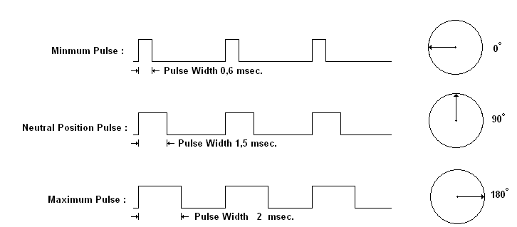
Control Waveforms

Slide 9
PWM
A control wire communicates the desired angular movement. The angle is determined by the duration of the pulse applied to the control wire.
The servo expects to see a pulse every 20 milliseconds.
The length of the pulse will determine how far the motor turns. A 1.5 millisecond pulse will make the motor turn to the 90 degree position (often called the neutral position).
If the pulse is shorter than 1.5 ms, then the motor will turn the shaft to closer to 0 degrees. If the pulse is longer than 1.5ms, the shaft turns closer to 180 degrees.

Slide 10
Modified Servos
Servo motors can also be retrofitted to provide continuous rotation:
Remove mechanical limit (revert back to DC motor shaft).
(Optional) Remove pot position sensor (no need to tell position) and replace it with 2 equal-valued resistors with a combined resistance equivalent to that of the pot. This makes the servo “think” it is in the 90 deg position.

Slide 11
Parallax Standard Servo
Provides 180° range of motion and position control
38 oz-in torque at 6 VDC
4 to 6 VDC
Maximum current draw is 140 +/- 50 mA at 6 VDC when operating in no load conditions
Pulse-width modulation, 0.75–2.25 ms high pulse, 20 ms intervals

Slide 12
Parallax Servo Connection

Slide 13
Power Precautions
Do not use this servo with an unregulated wall-mount supply.
Do not power this servo through the microcontroller’s Vdd pin.
Servo current draw can spike while under peak load
regulator should be prepared to supply adequate current for all servos used in combination.

Slide 14
BOE Jumper Connection
Be sure the jumper is set to Vdd (regulated 5 VDC for this board)

Slide 15
Communication Protocol

Slide 16
Parallax Continuous Rotation Servo
Bidirectional continuous rotation
0 to 50 RPM
a linear response to PWM for ramping
4 to 6 VDC
Maximum current draw is 140 +/- 50 mA at 6 VDC when operating in no load conditions

Slide 17
Continuous Servo Connection

Slide 18
Communication Protocol
Rotational speed and direction are determined by the duration of a high pulse, in the 1.3 -1.7 ms range.
Maximum RPM will vary with input voltage
50 RPM @ 5 V is typical

Slide 19
Timing diagram for a centered servo
Note that calibration is necessary

Slide 20
Timing diagram for a centered servo
As the length of the pulse decreases from 1.5 ms, the servo will gradually rotate faster in the clockwise direction

Slide 21
Timing diagram for Rotating Counter-clockwise
As the length of the pulse increases from 1.5 ms, the servo will gradually rotate faster in the counter-clockwise direction

Slide 22
BOE-BOT Digital Encoder
To measure the travelled distance of a wheel

Slide 23
Encoder Operations
The sensors emit infrared light and look for its return from a reflective surface.
They are calibrated for optimal sensing of surfaces a few millimeters away.
The Boe-Bot's wheels, even though they are black, reflect sufficient IR to cause the sensors to respond.
When a sensor "sees" part of a wheel, it pulls its output low.
When it's looking through a hole, its output floats, and the pullup resistor pulls it high.

Slide 24
IR Sensor
Because the sensors emit and detect only modulated IR (at about 7.8 kHz) they are relatively insensitive to ambient light.
Be aware, though, that some fluorescent fixtures may also emit light at this frequency and could interfere with their operation.

Slide 25
Sensor Output Signals
As a Boe-Bot wheel turns, the sensor will see an alternating pattern of hole - no hole - hole - no hole, etc.
each edge of the square wave will mark an increment of travel slightly more than 1/2 inch (1.27 cm)

Slide 26
Uncertainty and Errors
Wheel encoders are never perfect
Uncertainties in the effective wheel diameters can lead to position errors.
Further uncertainties in effective wheel spacing during turns can result in direction errors.
Small position and direction errors have a way of accumulating quickly
May need calibration periodically.

Slide 27
Sensor Connections

